Slide 1
AI-Powered Customer Complaint & Document Processing Pipeline
Batch Document Ingestion, Schema-Enforced Extraction, and Automated Operational Workflows
AI Capstone Project – Document Workflows & Generative AI
Live Deployment URL:
GitHub Repository: Python 3.10+ • LangChain • Pydantic v2 • Streamlit • AWS EC2 • Pandas • PyTest • OpenAI/Gemini API
UTKARSH GANGWAR | & | PRATEEK KUMAR

Slide 2
Operational Inefficiencies in Unstructured Support Intake
Core Challenges:
Manual Processing Bottlenecks: Customer grievances arrive via heterogeneous, unstructured formats (.pdf, .docx, .txt), forcing support teams to manually open, parse, and key in data.
Critical Escalation Delays: Severe issues (SLA outages, legal risks, security lockouts) get buried in general queues due to the absence of automated triage.
Inconsistent Communications: Customer response times lag, and internal incident briefs lack standardized root-cause formatting.
System Objective: An end-to-end, batch-processing engine deployed on cloud infrastructure that converts raw complaint documents into schema-validated JSON records, tailored resolution email drafts, executive summaries, and a consolidated CSV report.

Slide 3
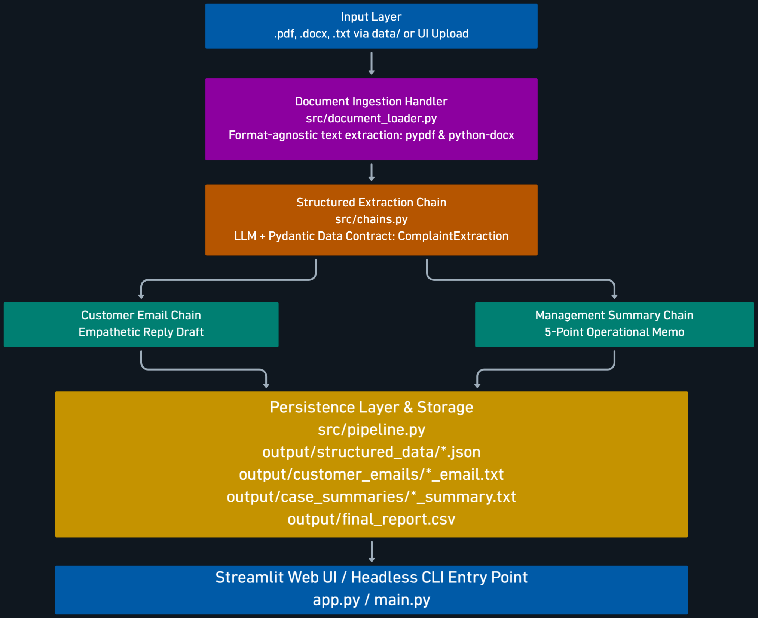

Modular Pipeline Architecture & Data Flow
Flowchart / Pipeline Diagram

Slide 4
Repository Architecture & Separation of Concerns
Key Design Highlights:
Root Entry Points (app.py, main.py): Lightweight controllers delegating pipeline logic to the src/ core library.
Decoupled Prompt Engineering (prompts/): Externalized prompt files (extraction_prompt.txt, customer_email_prompt.txt, case_summary_prompt.txt) allowing prompt updates without altering business logic.
Centralized Configuration (config/config.yaml): Model parameters (temperature, model name, provider) and system paths externalized in YAML.
Robust Logging & Self-Bootstrapping (src/logger.py, src/config.py): Rotating file handlers (logs/app.log) and auto-creation of output directories on container/system startup.

Slide 5
Schema-Enforced Field Extraction via Pydantic
Core Pydantic Schema (src/schemas.py):
customer_name: str (Guaranteed customer identifier)
email / phone_number: Optional[str] (Explicit None handling without hallucination)
complaint_category: str (Normalized category e.g., Billing, SLA Outage, Hardware)
issue_description: str (Factual root-cause statement)
resolution_provided: Optional[str] (Set strictly to None if grievance remains unresolved)
escalation_required: bool (Automated triage flag for immediate manager attention)
case_status: Literal["Open", "In Progress", "Resolved", "Closed"] (Restricted status domain)
Zero-Hallucination Guardrail: The prompt explicitly forbids the model from fabricating missing contact points or premature resolutions.

Slide 6
Automated Resolution Communication & Management Reporting
Stream 1: Customer Resolution Drafts (output/customer_emails/):
Synthesizes extracted details into a professional, empathetic email draft.
Clearly states current resolution or confirms active investigation status without promising unauthorized compensation or policies.
Stream 2: Executive Management Briefs (output/case_summaries/):
Standardized 5-section markdown document:
Case Overview
Key Issue & Root Cause
Action Taken / Current Resolution
Case Status & Escalation Level
Recommended Next Action

Slide 7
Cloud Infrastructure & Production Deployment Setup
AWS Deployment Topology:
Host Instance: Amazon EC2 (Ubuntu 24.04 LTS).
Process Management: systemd daemon configuration ensuring automated restarts on failure and persistent background execution.
Network & Security Configuration:
Custom AWS Security Group opening Port 8501 (Streamlit) and Port 22 (SSH).
Reverse proxy ready (Nginx) for SSL termination and static asset caching.
Environment Isolation: Python virtual environment (venv) managing dependencies pinned via requirements.txt.
Deployment Verification: Public Elastic IP / DNS link provided in the submission for direct cloud access.

Slide 8
Streamlit Operational Center Features
Key Capabilities (Include screenshots from your running deployment):
Global KPI Banner: Instant counts for Total Cases, Escalations Needed, Active/Pending Cases, and Average Processing Latency.
Batch File Ingestion: Sidebar uploader accepting single or multi-file batches (.pdf, .docx, .txt).
Filtered Action Queues: Dedicated tabs for Priority Escalations (escalation_required == True) and Active Work Queue (case_status in ["Open", "In Progress"]).
Document Inspector: Side-by-side inspection of validated JSON schemas, generated customer responses, and internal summaries for any selected ticket.

Slide 9
Test Coverage & Processing Metrics
Automated Unit Testing (pytest):
tests/test_document_loader.py: Validates text extraction, missing file handling, and rejection of unsupported formats.
tests/test_schemas.py: Verifies Pydantic type checking, field validation, and rejection of invalid enum values.
Empirical Benchmarks (Based on Test Data):
Multi-Format Processing: 100% successful ingestion across .pdf, .docx, and .txt files.
Latency: ~7.65s average roundtrip per file across all 3 LLM calls (Extraction, Email, Summary).
Extraction Accuracy: 100% compliance with Pydantic JSON contracts across all test runs.

Slide 10
Project Deliverables & Submission References
Deliverable Checklist:
Live Cloud Deployment URL: <provide_url>
GitHub Repository: Clean repository structure containing documented code, sample test files, and test suites.
Execution Modes Provided:
Web UI: streamlit run app.py
Headless CLI: python main.py
Unit Tests: pytest tests/ -v
Comprehensive Documentation: Full README.md covering architecture, local setup, deployment steps, and configuration settings.

